Slide 1
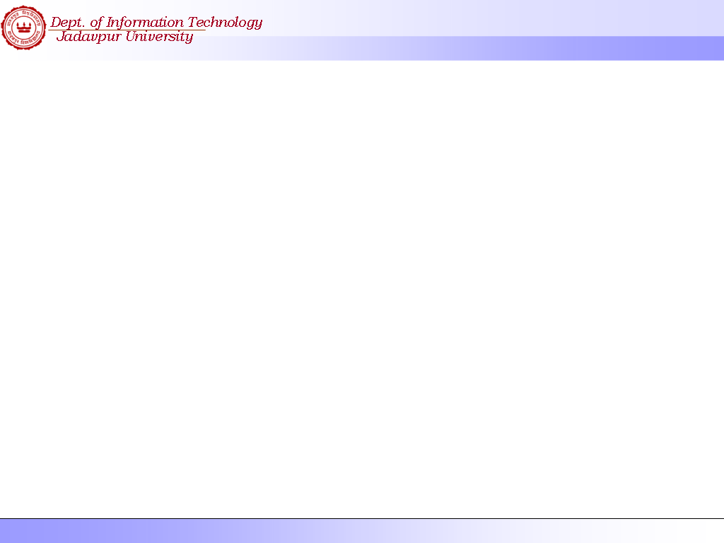
Different Software Development Life Cycle Models

Slide 2
Software Life Cycle
The phases necessary to develop and maintain a software system. These phases include:
  Requirements (Specification)
  Design
  Implementation (Coding)
  Testing (Validation)
  Maintenance (Evolution)
A software process model is an abstract representation of how these phases can be addressed.

Slide 3
Software Process Models
The Classical ‘Waterfall’ Model
Requirement
Analysis and
Definition
System And
Software
Design
Coding and
Unit
Testing
Integration and
System
Testing
Operation and
maintenance

Slide 4
Waterfall Strengths
Easy to understand, easy to use
Provides structure to inexperienced staff
Milestones are well understood
Sets requirements stability
Good for management control (plan, staff, track)
Works well when quality is more important than cost or schedule

Slide 5
Waterfall Deficiencies
All requirements must be known upfront
Deliverables created for each phase are considered frozen – inhibits flexibility
Can give a false impression of progress
Does not reflect problem-solving nature of software development – iterations of phases
Integration is one big bang at the end
Little opportunity for customer to preview the system (until it may be too late)

Slide 6
When to use the Waterfall Model
Requirements are very well known
Product definition is stable
Technology is understood
New version of an existing product
Porting an existing product to a new platform.

Slide 7
Incremental Development Model
Define Outline
Requirement
Assign
Requirements to
Increments
Design System
Architecture
Develop
System
Increment
Validate
Increment
Integrate
Increment
Validate
System

Slide 8
Incremental Development Model
Rather than deliver the system as a single delivery, the development and delivery is broken down into increments with each increment delivering part of the required functionality.
User requirements are prioritised and the highest priority requirements are included in early increments.
Once the development of an increment is started, the requirements are frozen though requirements for later increments can continue to evolve.

Slide 9
Incremental Development Model: Advantage
- Provides better support for process iteration
  Reduces rework in the software construction process
  Some decisions on requirements may be delayed
  Allows early delivery of parts of the system
  Supports easier integration of sub-systems
  Lower risk of project failure
  Delivery priorities can be more easily set

Slide 10
Incremental Development Model:
Disadvantages:
  Increments need be relatively small
  Mapping requirements to increments may not be easy
  Common software facilities may be difficult to identify
Applicability:
  When it is possible to deliver the system “part-by-part”

Slide 11
Rapid Application Development (RAD) Model
Business
Modeling
TEAM #2
Data
Modeling
Process
Modeling
Application
Generation
TEAM #1
Testing
And
Turnover
60 – 90 days

Slide 12
Characteristics of RAD Model
- Very short Development Cycle (60 to 90 days)
- Component based construction is encouraged
- Requirement should be well understood to make a project follow RAD model
- The modularized approach is very essential for success of RAD
- RAD should not be followed if technological risks are there
- Sufficient man power should be available to form multiple RAD team

Slide 13
Rapid Application Model (RAD)
Requirements planning phase (a workshop utilizing structured discussion of business problems)
User description phase – automated tools capture information from users
Construction phase – productivity tools, such as code generators, screen generators, etc. inside a time-box. (“Do until done”)
Cutover phase -- installation of the system, user acceptance testing and user training

Slide 14
RAD Strengths
Reduced cycle time and improved productivity with fewer people means lower costs
Time-box approach mitigates cost and schedule risk
Customer involved throughout the complete cycle minimizes risk of not achieving customer satisfaction and business needs
Focus moves from documentation to code (WYSIWYG).
Uses modeling concepts to capture information about business, data, and processes.

Slide 15
RAD Weaknesses
Accelerated development process must give quick responses to the user
Risk of never achieving closure
Hard to use with legacy systems
Requires a system that can be modularized
Developers and customers must be committed to rapid-fire activities in an abbreviated time frame.

Slide 16
When to use RAD
Reasonably well-known requirements
User involved throughout the life cycle
Project can be time-boxed
Functionality delivered in increments
High performance not required
Low technical risks
System can be modularized

Slide 17
Spiral Model: Characteristics
  A hybrid model that support process iteration
  The process is represented as a spiral, each loop in the spiral representing a process phase
  Four sectors per loop: objective setting, risk assessment and reduction, development and validation, planning
  Risk is explicitly taken into consideration

Slide 18
Spiral model
Deter
mine objecti
v
es,
Ev
alua
te alterna
alterna
ti
v
es and
ti
v
es,
constr
aints
Risk
identify
, r
esolv
e risks
anal
ysis
Risk
anal
ysis
Risk
Oper
a-
anal
ysis
Pr
ototype 3
tional
Pr
ototype 2
pr
oto
ype
Risk
Pr
oto-
R
EVI
EW
anal
ysis
type 1
R
equir
ements plan
Sim
ula
tions
, models
, benchmar
ks
Life-cy
cle plan
Concept of
Oper
a
tion
S/W
r
equir
ements
Pr
oduct
Detailed
design
design
De
v
R
equir
ement
elopment
v
alida
tion
plan
Code
Integ
r
a
tion
Design
Unit test
and test plan
V&V
Integ
r
a
tion
Plan ne
xt phase
Acceptance
test
Service
test
De
v
elop
, v
erify
ne
xt-le
v
el pr
oduct

Slide 19
Spiral Model Strengths
Provides early indication of insurmountable risks, without much cost
Users see the system early because of rapid prototyping tools
Critical high-risk functions are developed first
The design does not have to be perfect
Users can be closely tied to all lifecycle steps
Early and frequent feedback from users
Cumulative costs assessed frequently

Slide 20
Spiral Model Weaknesses
Time spent for evaluating risks too large for small or low-risk projects
Time spent planning, resetting objectives, doing risk analysis and prototyping may be excessive
The model is complex
Risk assessment expertise is required
Spiral may continue indefinitely
Developers must be reassigned during non-development phase activities
May be hard to define objective, verifiable milestones that indicate readiness to proceed through the next iteration

Slide 21
When to use Spiral Model
When creation of a prototype is appropriate
When costs and risk evaluation is important
For medium to high-risk projects
Long-term project commitment unwise because of potential changes to economic priorities
Users are unsure of their needs
Requirements are complex
New product line
Significant changes are expected (research and exploration)

Slide 22
Conclusion
Software Prototyping Benefits
Requirement Elicitations and Validations
Reducing the mis-understanding between the s/w developers and the customers
A quick working system is available to demonstrate, training and testing
Helps to minimize expensive design errors
It is the only way to get a 100% fool-proof system where User Interface plays a major role
This process can be treated as a part of the specification process or a process before it.

